Slide 1
Enhance the after-discharge mortality rate prediction via learning from the medical notes
Zijiang YANG
zy4957@utexas.edu

Slide 2
Electronic Health Records
Electronic Health Records (EHR) data has revolutionized thepatient management, treatment planning, readmission and length-of-stay prediction.
providing unprecedented information to discover the patients’ health condition and study the disease progression
However, the data contains both the structured and unstructured ones.
Unstructured data like medical notes are difficult to analyze as they are often messy, irregular, repetitive and redundant.

Slide 3
Basics of the data
We uses MIMIC III data to learn medical notes. MIMIC-III is a large and freely available database comprising deidentified health-related data associated with more than 40,000 patients who remained in critical care units of the Beth Israel Deaconess Medical Center between 2001 and 2012.
Tables considered:
patient This records the basic information of the patient such as the age, ethnicity, marital status and so on.
admission This records the ICU admission and discharge information for the patients.
diagnoses This records the diagnoses for the patients.
ICD diagnosis This records the ICD code of the diagnosis for the patients.
noteevents This records the medical notes for the patients.

Slide 4
After-discharge mortality prediction
based on the discharge date and the death date, we compute the label ’Survive 30 days after discharge’ for each patient: 1 for survival and 0 for death.
The same process is repeated for 15-days, 60-days, 90-days and 365-days.

Slide 5
Basic information only
We try to predict the mortality using the basic information such as age, gender, marital status and so on.
Model considered:
Logistic regression
Random forest
XGBoost

Slide 6
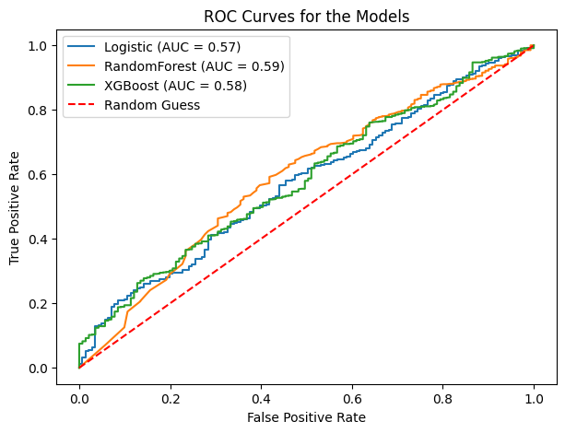
Basic information only
It is reported that these 3 models have very similar model accuracy.
Based on the result, we can see that these models cannot deliver a good result. The AUC is just around 0.58, which barely outperforms the random guessing.
30-days mortality prediction

Slide 7
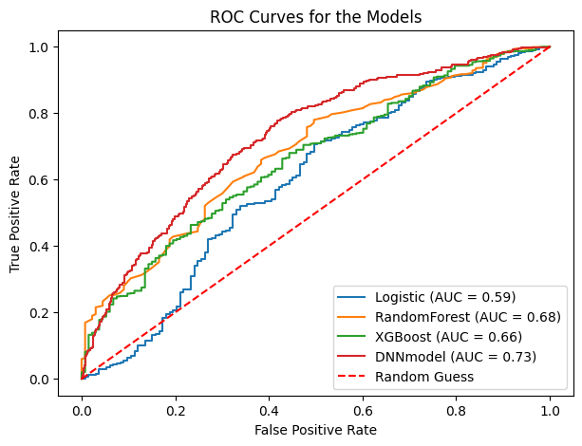
Medical note information
We are able to observe a significant improvement: all models perform better than basic information only;
For example, the AUC increase by 0.09 from 0.59 to 0.68 for the Random forest method.
30-days mortality prediction

Slide 8
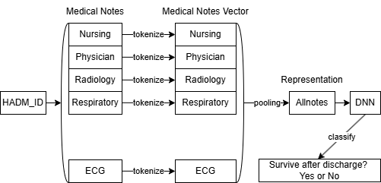
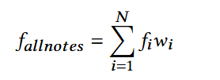
Proposed method
Previous researchers treat each medical note equally, where 𝑤𝑖 is the same for all 𝑖.
However, different medical notes belong to different categories. They may contain different amount of useful information.
For example, current Nursing notes often repeats the content of the previous Nursing note.
Treating them equally will down-weigh the important ones and up-weigh the repetitive ones

Slide 9
Proposed method
We build up our method by constructing the pooling weight and passing it into a Deep Neural Network(DNN) as a learnable parameter. Basically, we learn the weight wi from the training process.
In our experimental settings, we configure the DNN as 4-layerneural network with 2 hidden layers. The hidden layer size is set to be 70. All the hidden layers have short-cut links interconnected.

Slide 10
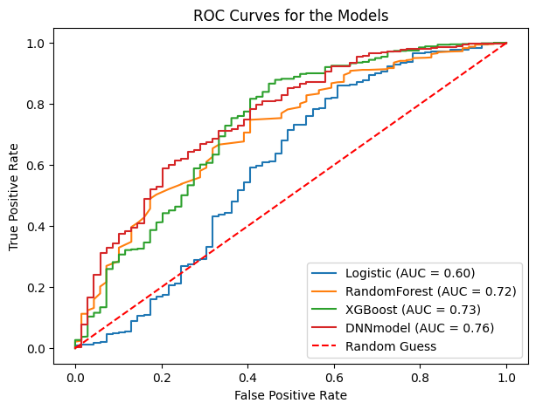
Performance of the proposed model
15-days mortality prediction
30-days mortality prediction

Slide 11
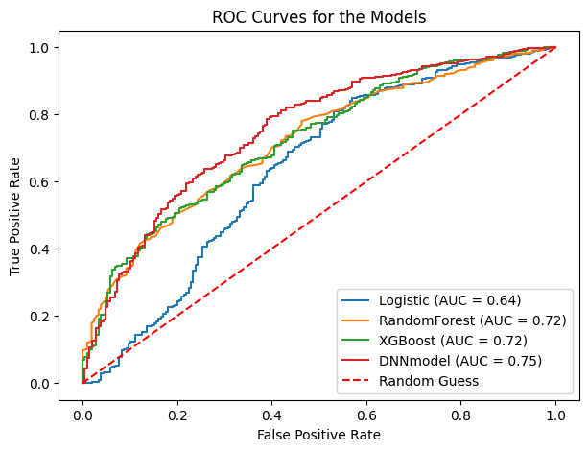
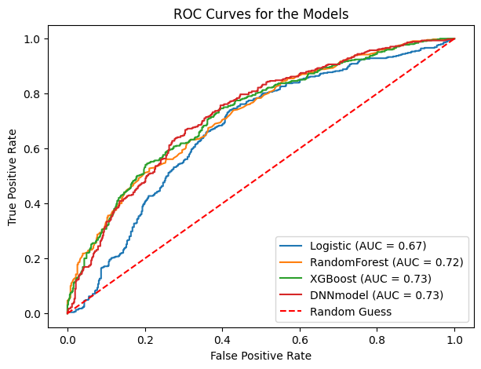
Performance of the proposed model
60-days mortality prediction
365-days mortality prediction

Slide 12
Model evaluation
DNN based method achieves best performance across all the time spans.
It outperforms the traditional machine learning methods by 2% to 14% based on the AUC-ROC criterion.
It is worth noting that the DNN gives a better performance than the prevailing tree based methods for the medical prediction task.

Slide 13
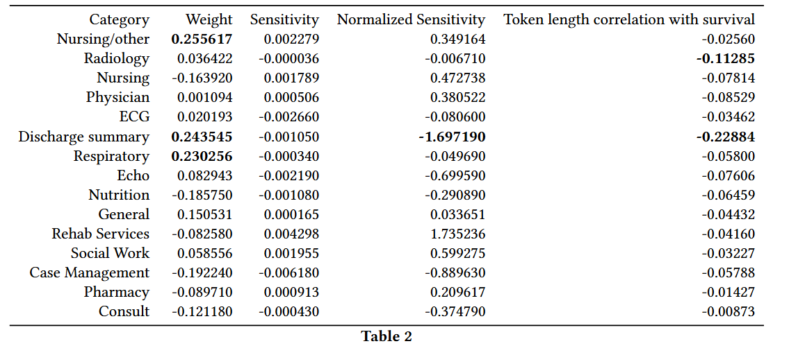
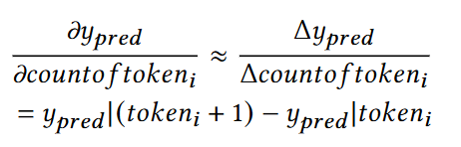
Sensitivity analysis
We conduct the sensitivity analysis based on the DNN model.
We discover that the ‘Discharge summary’ is most informative category.
The ‘Nursing/other’ and ‘Nursing’ also gives useful information.

Slide 14
Conclusion
Based on the experiments, our results confirm the value of medical notes for the after-discharge mortality prediction. The AUC-ROC for the models using medical note information is generally 0.1 higher than that without using the medical notes.
The performance of our DNN model achieves the best prediction performance for15-days, 30-days, 60-days and 365-days after-discharge mortality. The proposed model outperforms the traditional models by 2% to 14% based on the AUC-ROC criterion.
It is found that ’Discharge summary’ and ’Nursing’ are the most informative categories for predicting the mortality among the categories of the notes.

